Slide 1
Laser Flash Analysis Work
A. Wylie

Slide 2
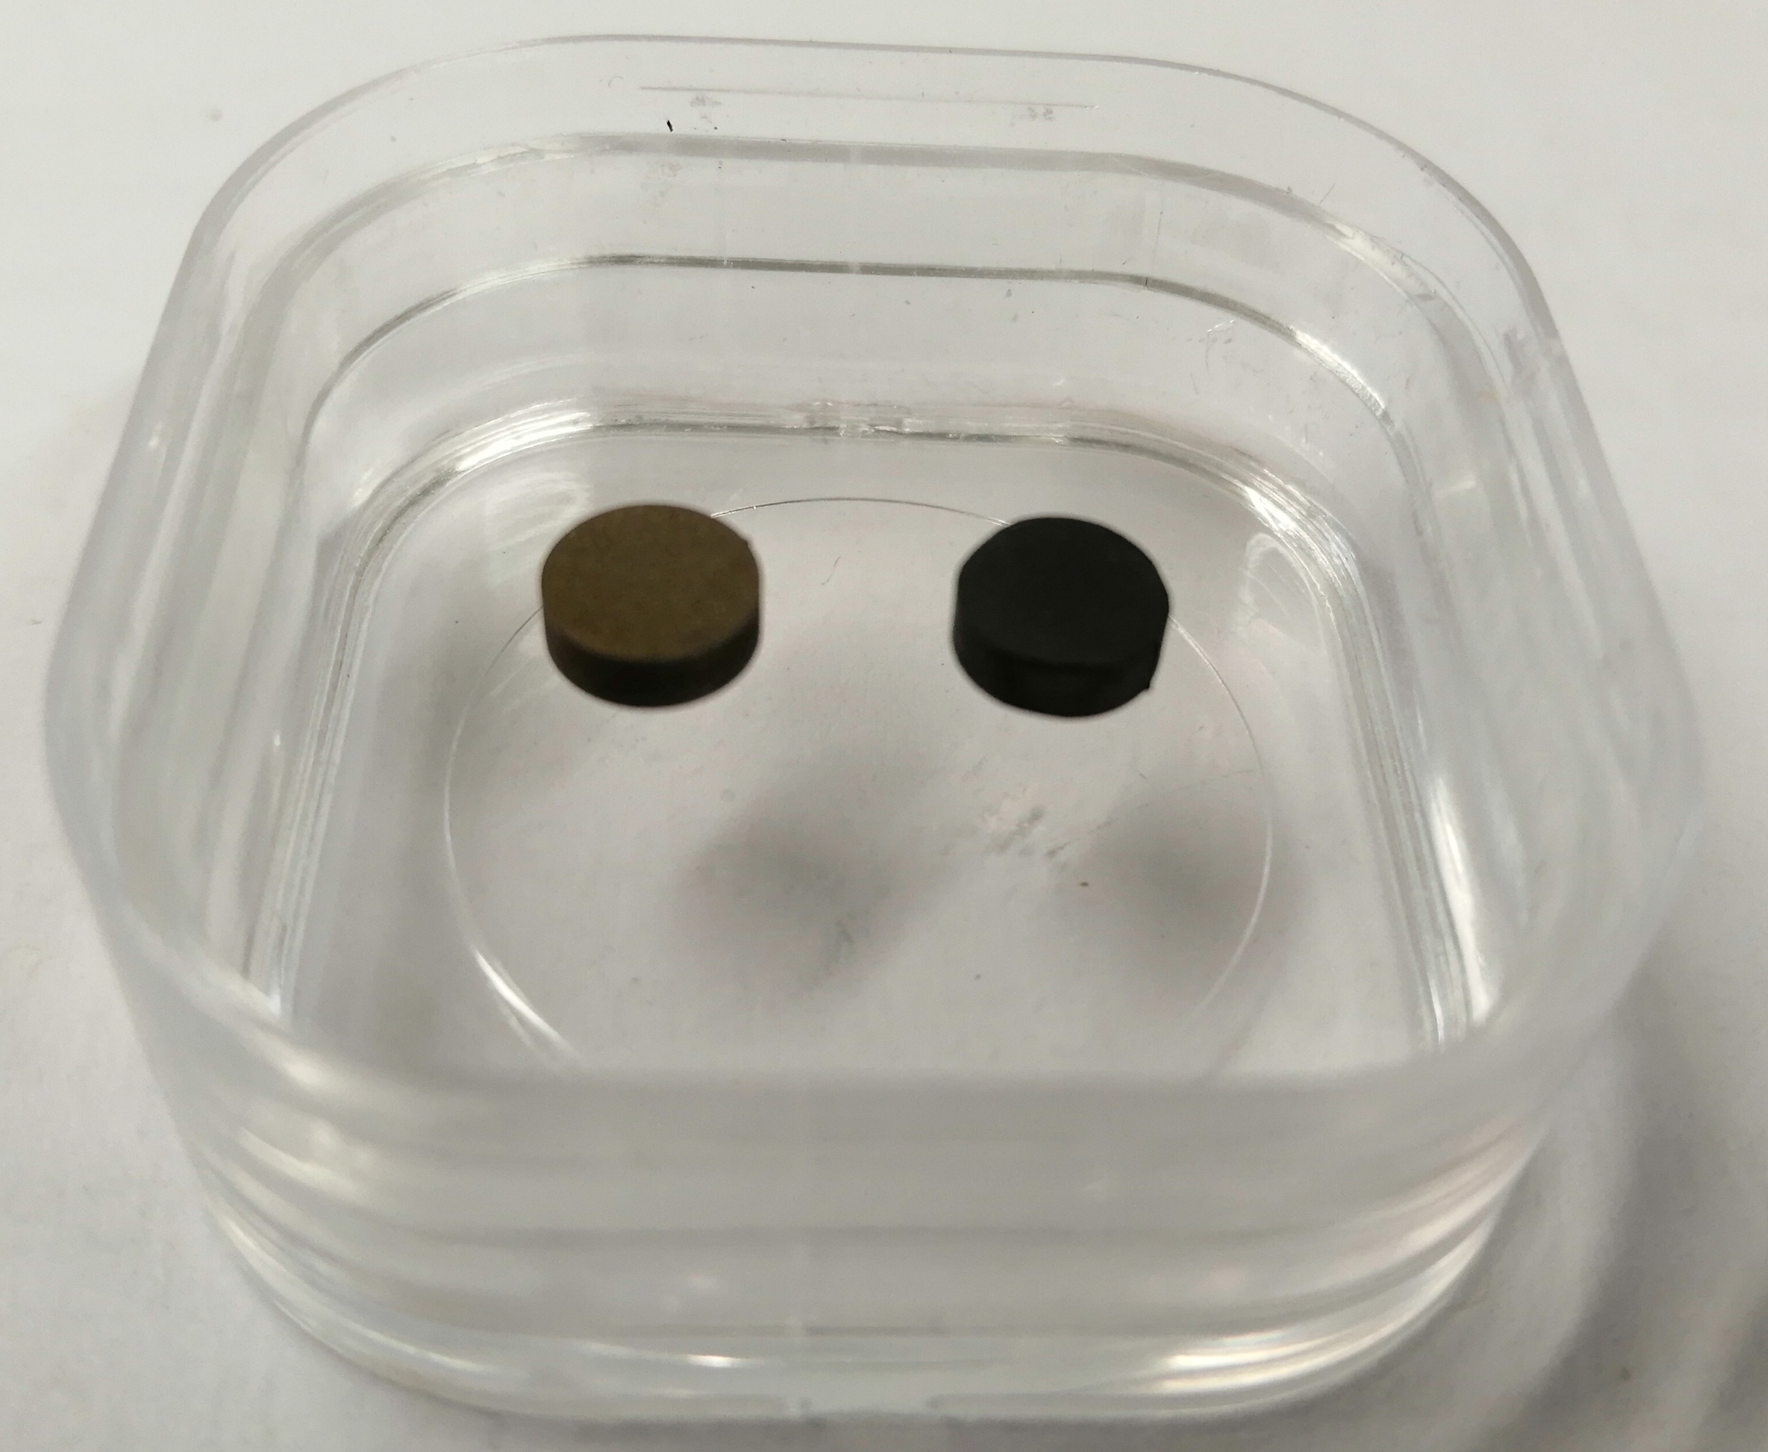
Create reference data for Eurofer to which TGS can be compared
Netzsch LFA 427 laser flash apparatus/pyrometer performed by Andy Wallwork [andrew.wallwork@manchester.ac.uk]
Temperature ranged from RT to 700°C (intended operating temp is 450-750 °C)
Billet 6 mm diameter, 2 mm thickness cut using EDM & carbon-coated
6 mm
Pre-LFA
Post-LFA
(carbon coated)
2 mm

Slide 3
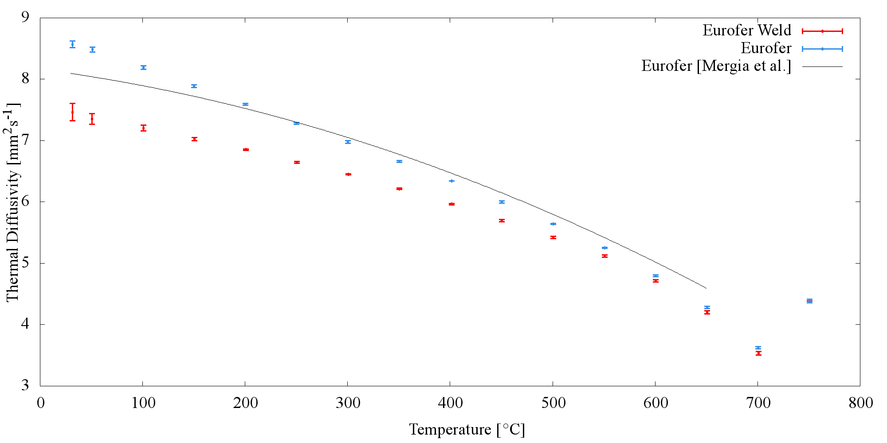
Eurofer and Eurofer Weld LFA Thermal Diffusivity RT – 750 °C

Slide 4
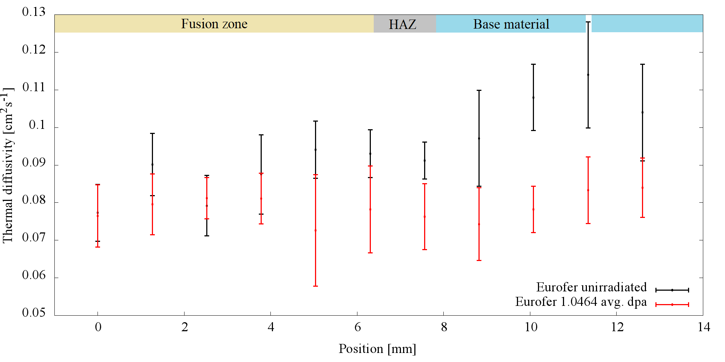
Iron Ion 5MeV Irradiated Eurofer TGS Thermal Diffusivity Study, RT [MIT 2019]

Slide 5
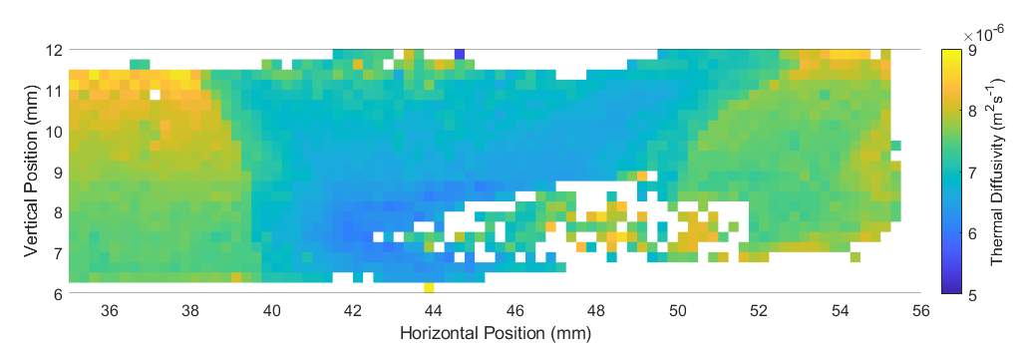
Eurofer Weld TGS Thermal Diffusivity Map [collab. with M. Reza, Oxford]

Slide 6
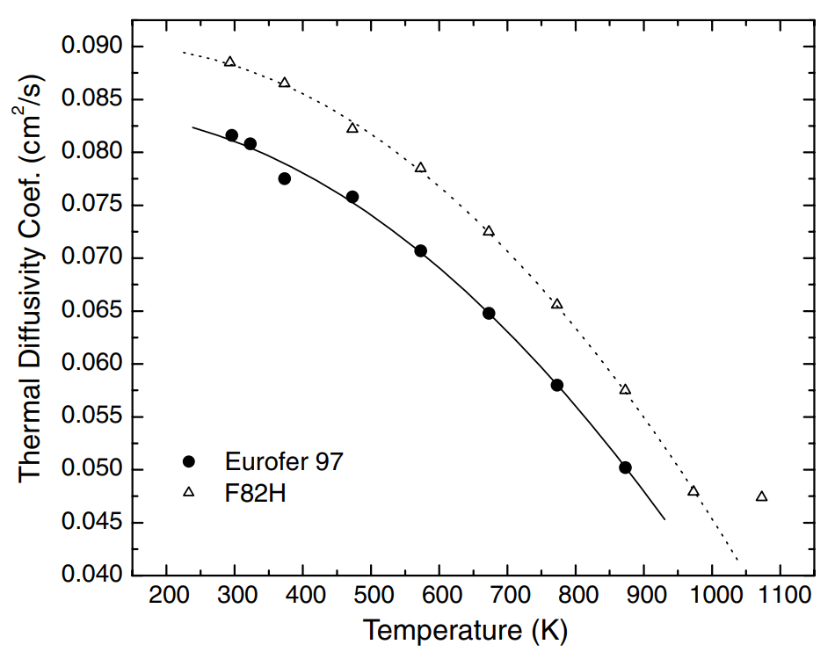
Room Temp Thermal Diffusivity of Eurofer [mm²s⁻¹]
Data Source | Eurofer | Eurofer Weld
LFA [Manchester] | 8.57(5) | 7.46(14)
TGS [MIT] | 10.9(8) | 8.2(7)
TGS [Oxford]
LFA [Mergia et al. (2008)] | 8.2
[Mergia et al. (2008)]

Slide 7
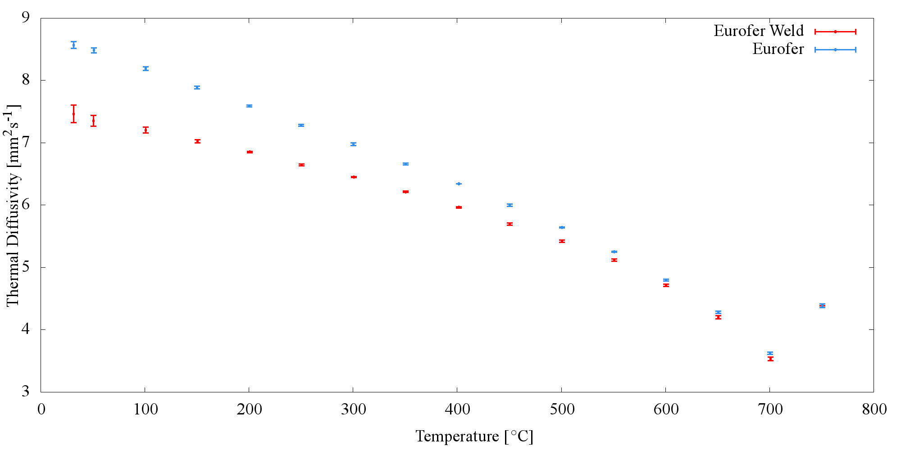
Eurofer and Eurofer Weld LFA Thermal Diffusivity RT – 750 °C

Slide 8
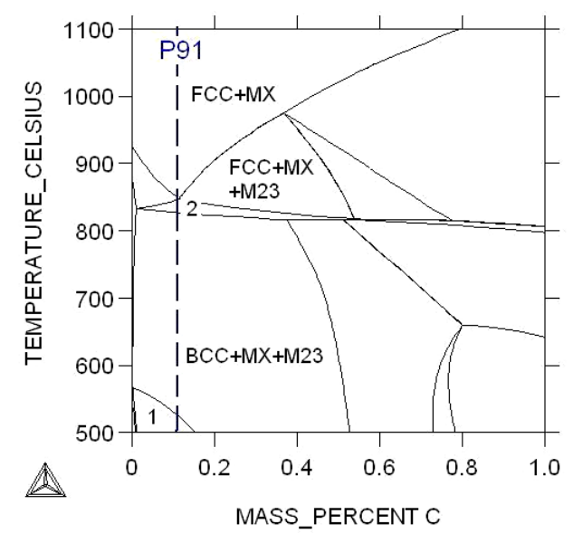
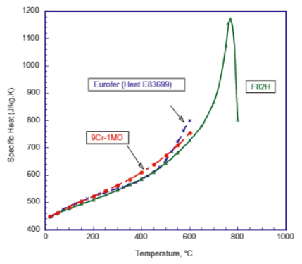
Heat Capacity
[Tavassoli et al. (2004)]
[Foret et al. (2012)]
Also see: https://inis.iaea.org/collection/NCLCollectionStore/_Public/28/071/28071477.pdf

